Slide 1



WELCOME TO
SATBIR INDUSTRIES (REGD.)
An IATF 16949 Certified Company
Website:- satinds.com
E-mail:- satbirindustries@yahoo.in

Slide 2

Company Profile
Satbir Industries (REGD.) an IATF 16949 Certified company which is engaged in manufacturing of hot forged components. We are one of the largest manufacturers of hot forged nuts in India. State of the Art manufacturing facilities are managed by highly skilled work force and dedicated team of quality professionals to deliver the best quality products at economical prices to our customers on global platform.

Slide 3


MISSION & VISION
Our Mission
Our Vision
Our mission is to provide our clients with high-quality fasteners & all types of forging components in various kinds of metals at affordable prices. Our sales and development are done through a market-focused and process-oriented approach. We have recruited the best possible employees, partners, and machinery in the hopes of achieving what we strive for.
To cater each and every demand of the customer and give them full satisfaction because we believe in the fact that "THE CUSTOMER ALWAYS COMES FIRST". To be a leading manufacturer and supplier in providing material specific solutions with our fasteners.

Slide 4
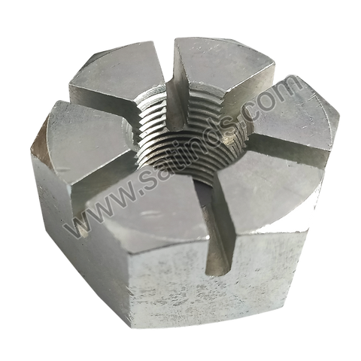
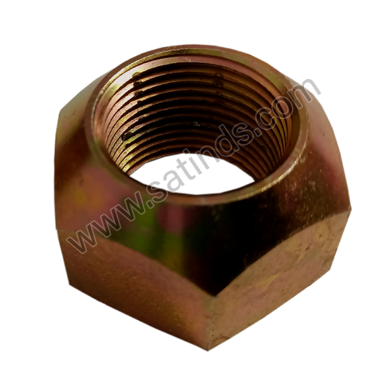
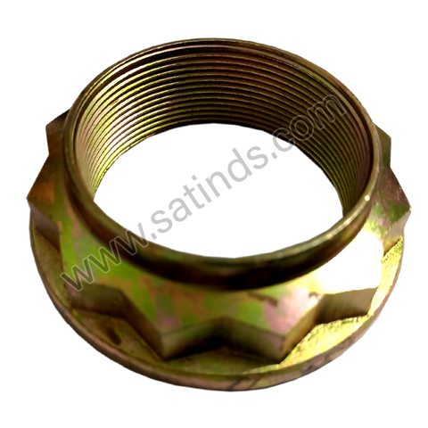

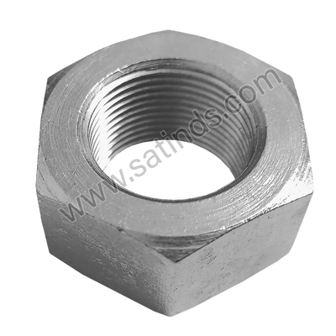
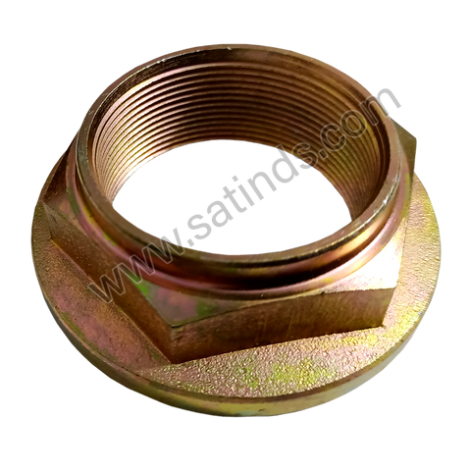
OUR PRODUCTS
Slotted Nuts
Nylock and Cleveloc Nuts
Special & Star Nuts
Hex Nuts
Hex Collar Nuts

Slide 5
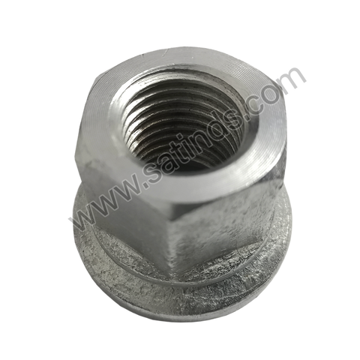
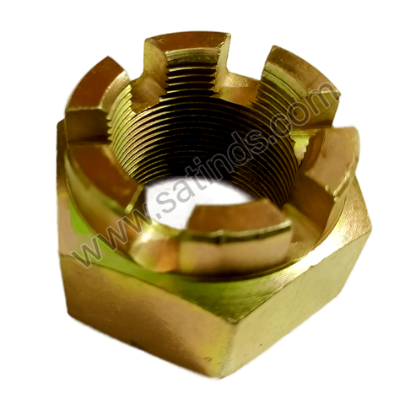
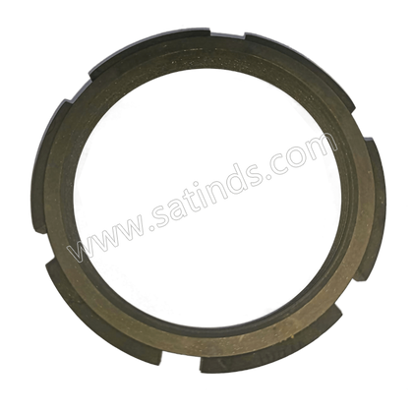
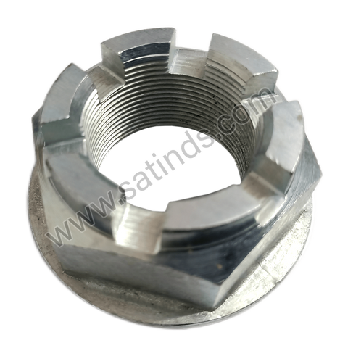
OUR PRODUCTS
Axle Check Nuts
Wheel Nuts
Castle Nuts
Flange Slotted & Flange Nuts

Slide 6


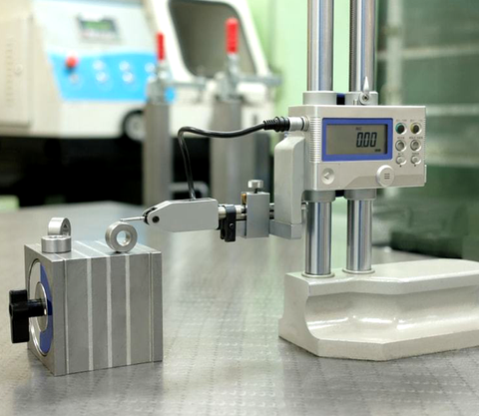
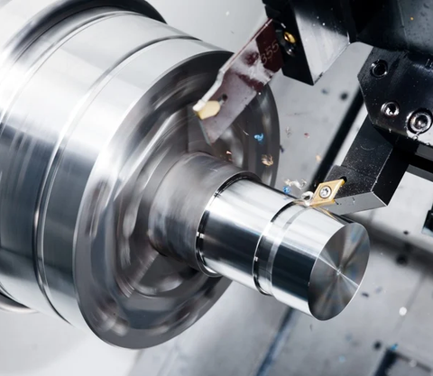
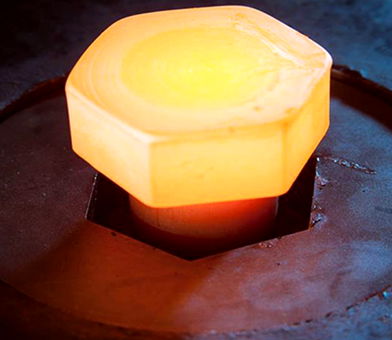
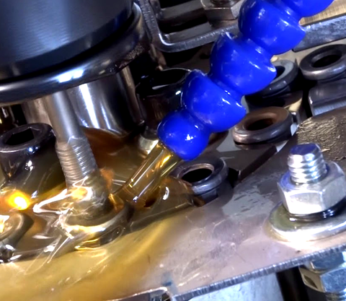
INFRASTRUCTURE
Tool Room
Standard Room
CNC Machine Shop
Hot Forging
Special Purpose & Tapping
Machines

Slide 7

We have selected a team of knowledgeable & experienced engineers, production staff and sales representatives. With the assistance of their collective efforts, we are capable of accommodating client’s special need as per their exact specifications. Our professionals give their best in order to offer our valuable clients high quality products as per their detailed specifications. These professionals also inspect the entire range on different parameters to eradicate all the flaws from the assortment.
OUR TEAM

Slide 8

Manufacturing Capacity and Future Plan
We are currently manufacturing 7 lakh pcs /month with monthly consumption of 150 ton Raw Material using a team of 150 skilled workers and professionals. Our annual turnover is approx Rs. 20 Crore which we are expecting to increase to Rs.100 crore in next 3-4 years by increasing the production of current products and adding new products as well.
For Our Future Expansion, We have already procured 1.25 acre land and construction has already started.

Slide 9




Get in Touch
Address:-
Corporate Office – # 10932 , Street No. – 9, Partap Nagar, Industrial Area – B, Ludhiana-141003.
Unit-II – Ganpati Estate, Vill. Tibba, Sahnewal, Ludhiana-141120
+91-99144-00485 | +91-98142-00485
+91-98141-00485
satbirindustries@yahoo.in
satinds.com

